Slide 1
Audio and Voice Modulation
Daniel Honrales

Slide 2
Mini Seminar

Slide 3
What if we could adjust the tone of a sentence?

Slide 4
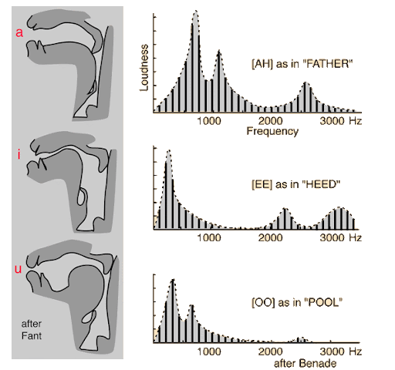
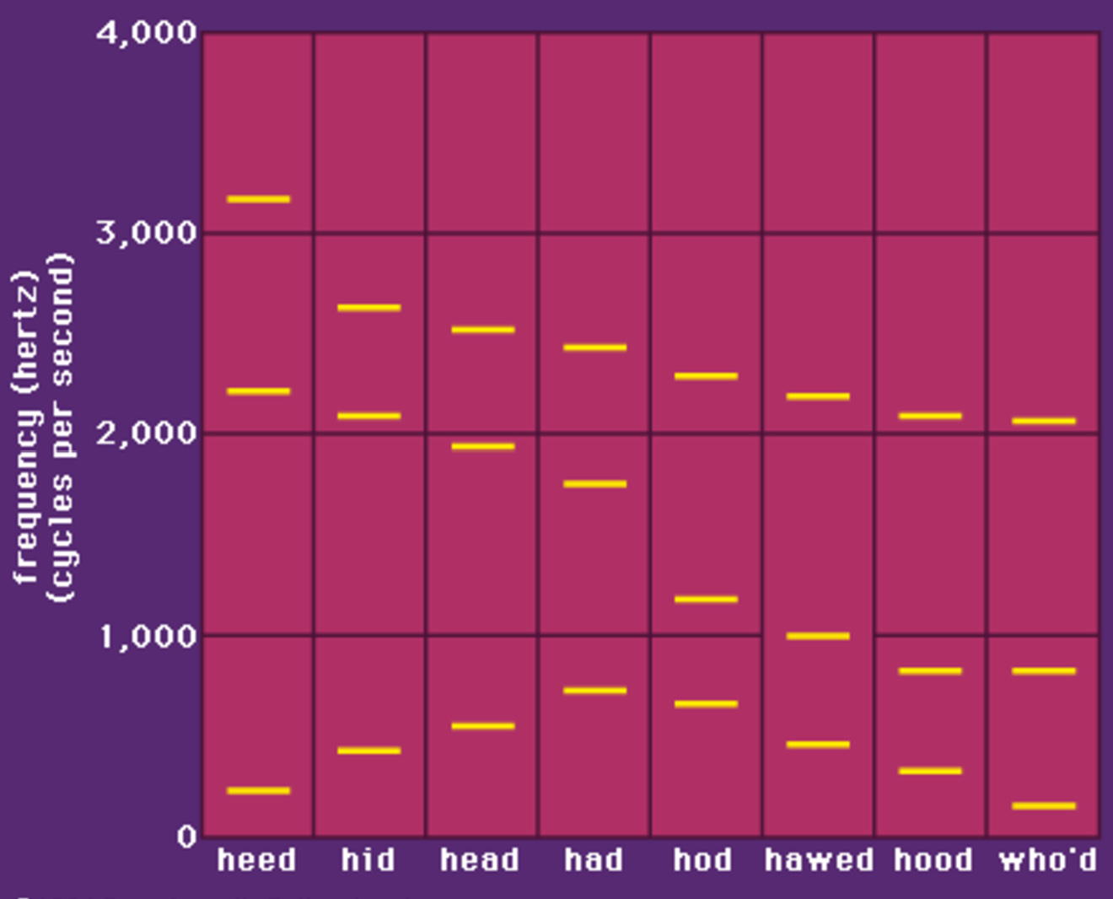
Human Speech
Humans vocalize sound by pushing air through larynx and vocal tract
Everyone’s voice sounds different – f0
Formants allow us to universally recognize speech – f1…fn

Slide 5
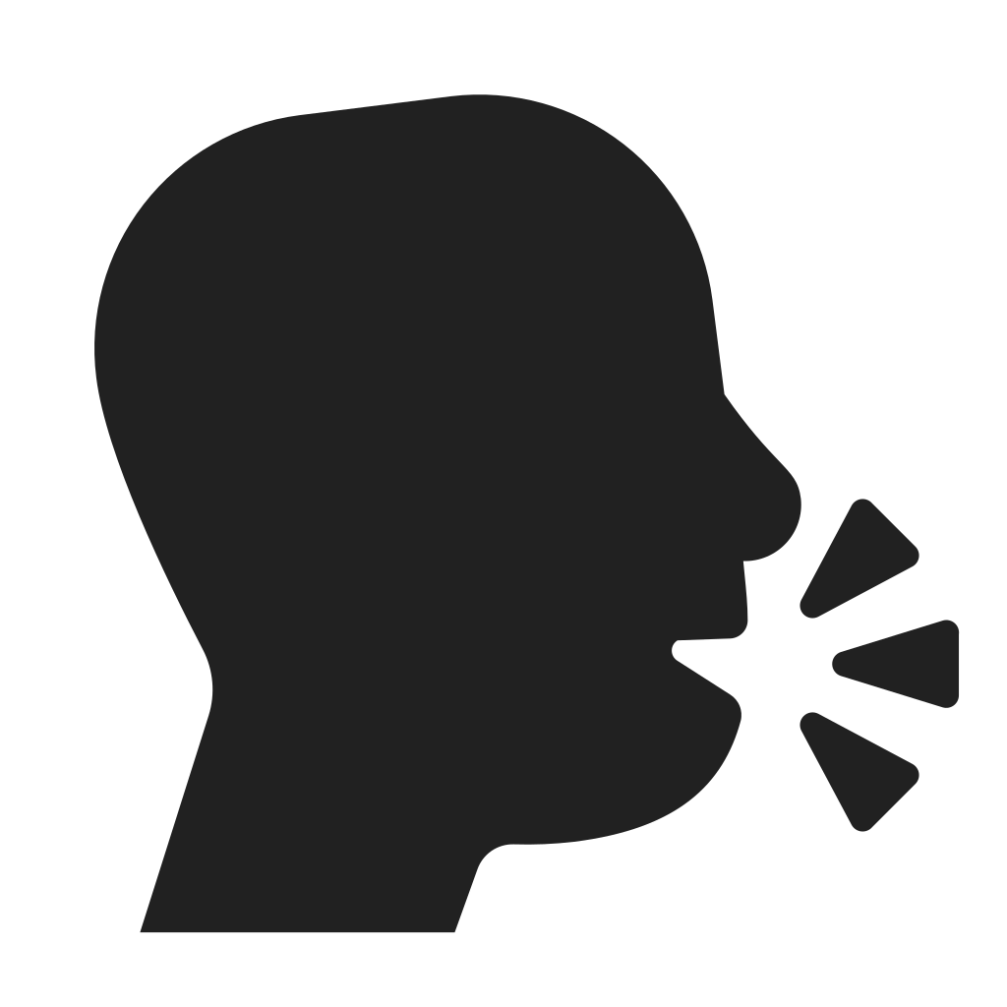


Areas of Interest
Recognition
Modulation
Synthesis

Slide 6
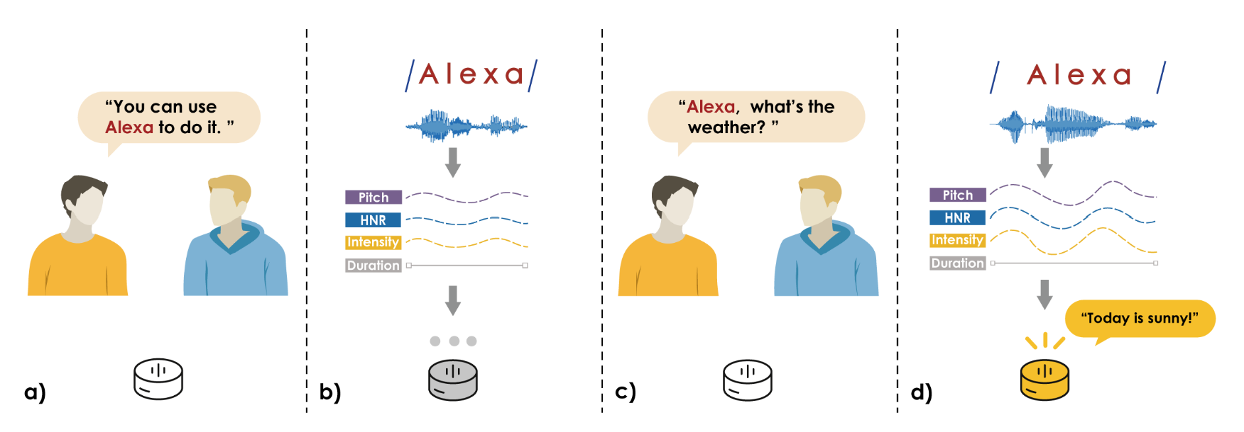
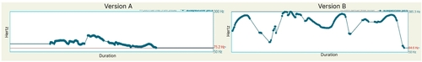
Voice Modulation
Conveys emotion, form, intention, etc.
Involves prosody characteristics - pitch, intensity, rate, etc.
Complex system
Voluntary vs. Genuine
Context-dependent
Ethically, public is open to voice modulation
Unless the speaker is unaware

Slide 7
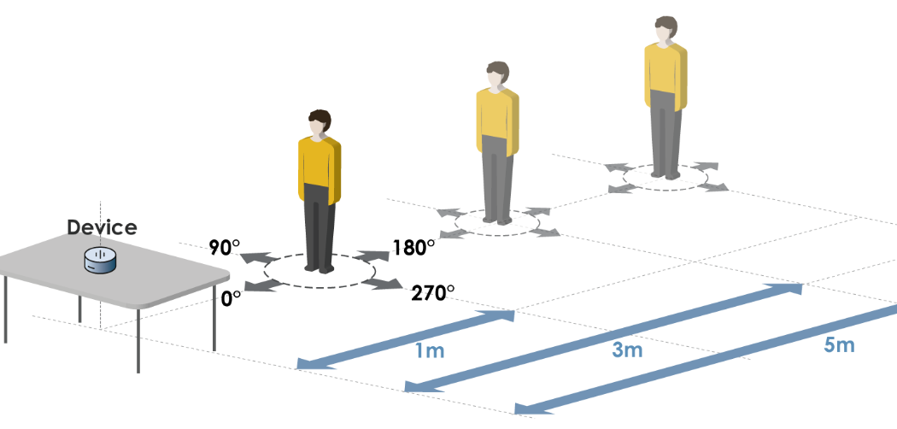
Existing Work
Aware (CHI 22)
How to consider context and intention of vocalization during recognition?
Calling vs non-calling references to a smart device
Prosody matters more than orientation or distance
Emotional Regulation (CHI 24)
How to reduce perceived anger and stress in customer service calls?
Voice modulation
Explored changing pitch level and contour
Accent Conversion (MM 24)
How to change the accent of a vocalization?
Simplified training process to reduce data requirements
Converts semantics, synthesize speech in target accent
https://convert-and-speak.github.io/demo/

Slide 8
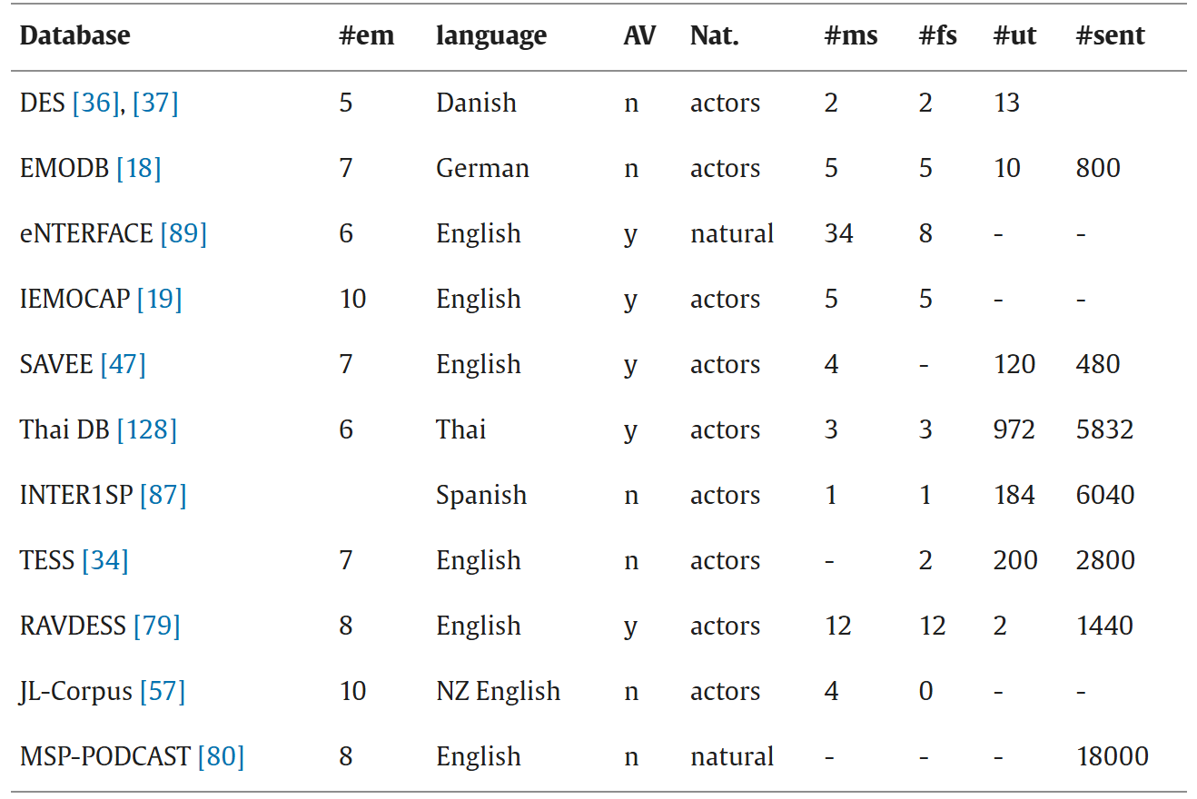
Ideation
Main Challenges
Feature Selection
Dependent on purpose
Must be explored
Real-time Modulation
Text-to-speech vs speech-to-speech
Software and Training
Data collection
Within-individual

Slide 9
Ideation
Applications
Interface
Wearable, in-person, real-time
Purpose
Emotion / Tone conversion – ex. Sad vocalization becomes happy
Foreign language practice – ex. Interactive back-and-forth vocalization
Public speaking practice / converter – ex. VR experience with live feedback
Non-vocal modulation – ex. Imbue baby’s cry with less harsh sounds

Slide 10
Background Work

Slide 11
Voice Modulation: from origin and mechanism to social impact (2021)
https://royalsocietypublishing.org/doi/full/10.1098/rstb.2020.0386
Lit review of voice characteristics and modulation’s effect on speech/perception
Vocal properties can convey sex, age, body size, emotions, etc.
Voice modulation present in verbal and non-verbal communication
Humans possess advanced vocal control as compared to other species
Vocal parameters
Base pitch / Fundamental frequency (f0)
Vocal tract resonances / Formant frequencies (specific frequencies preferred by individual vocal tract)
Social cues understood through voice modulation, and we recognize speakers despite vocal changes
Non-vocal signs of aggression (e.g. roars) convey physical strength
Biology / Neuro
Vocal control enacted by innervation of human larynx through direct connection between primary motor cortex and nucleus ambiguous
This pathway is more present and complex in humans compared to other primates
Singers exhibit stronger neural representations of larynx height in a region of dorsal somatosensory cortex, correlated with more accurate performance in vocal size and pitch tasks

Slide 12
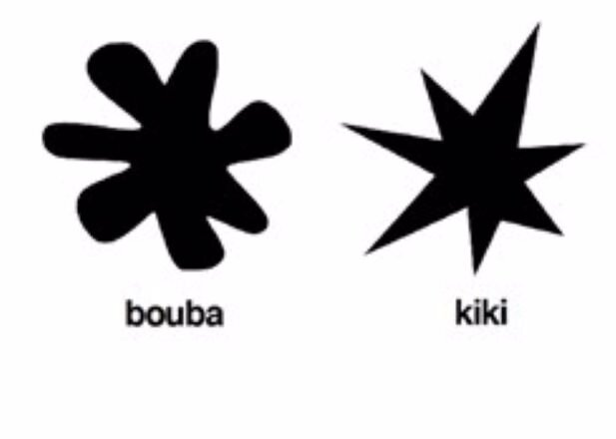
Modulation
Listeners can distinguish volitional vs. genuine laughs and cries, genuine vocalizations seen as more trustworthy and arousing
Vocalizers tend to adjust their overall pitch when speaking to figures of authority, disputed whether raise or lower
Modulation differs across cultures, but there are some universals
Most research is in WEIRD scope (western, educated, industrialized, rich, democratic)
Words can carry inherent properties (ex. Bouba perceived as round, kiki perceived as sharp)
People modulate their voice in response to background speech more than any other kind of background noise
Ethics
Voice modulation and applications generally accepted by public
One exception is when the vocalist does not provide consent

Slide 13
Supporting Interpersonal Emotional Regulation of Call Center Workers via Customer Voice Modulation (CHI 2024)
https://dl.acm.org/doi/full/10.1145/3613905.3650968
Can we reduce perceived anger/stress in a customer’s audio for call center workers?
Emotion in speech signified by 3 prosodic features: pitch (frequency) , energy (contour) , duration (rate)
Chose to modulate pitch and energy due to strong correlation with anger and goal for real-time modulation
Study
14 participants mostly 20-24 years old, 10 women
Rated stress, arousal (intensity), and valence(pos/neg) in audio and arousal, valence, and content comprehension in self
Method
Used Pratt (speech analysis software) to distinguish anger features and modulate audio samples
Conditions
C1 – no modulation
C2 – lowered pitch (-50hz)
C3 – remove pitch contours (monotone pitch level)
C4 – combine C2 and C3

Slide 14
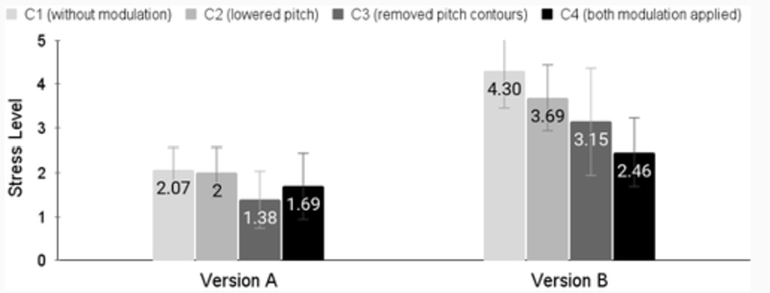
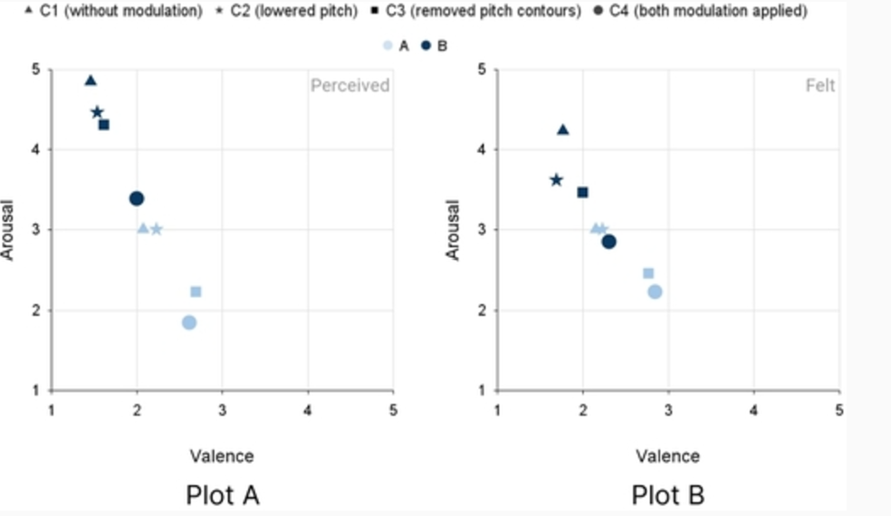
Version A is rude comment with neutral tone, B is rude comment with aggressive tone
B found to contain more stress
Removing pitch contours for monotone reduced stress in both versions
Lowering pitch frequency reduced stress in version B
Absence of intonation seems to be most significant factor
Participants experienced less intensity and negativity with modulated audio
No significant effect on content comprehension found
Notable Points
Demonstrates change in perceived anger/stress by modulating speech prosody
Tested on recorded audio, not real-time
Recorded audio from actors, not real instances of customer anger

Slide 15
Aware: Intuitive Device Activation Using Prosody for Natural Voice Interactions (CHI 22)
https://dl.acm.org/doi/pdf/10.1145/3491102.3517687
How to consider context of vocalization in recognition?
How to understand speaker’s intention through speech?
Must be inferred from prosody of speech
Prosody
Pitch, Intensity, Rhythm -> Form, Emotion, Intention
Study measures intonation (pitch variation), intensity, duration when calling / not calling a device
Physical characteristics of speaker can affect voice quality, this study focuses on positioning and distance
Measured by Harmonic-to-Noise Ratio (HNR), similar to Signal-to-Noise (SNR)

Slide 16
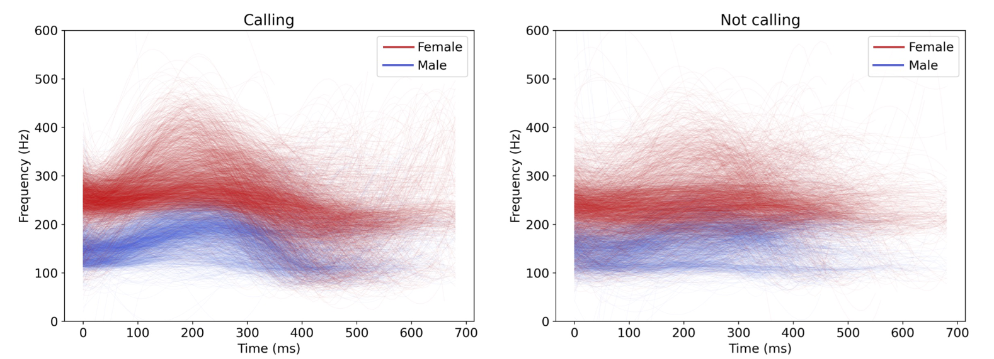
Aware: Intuitive Device Activation Using Prosody for Natural Voice Interactions (CHI 22)
Experiment
Participants read sentences referring to a device from different distances and orientations
4 directions, 3 distances
3 sentences talk TO the device, 3 sentences talk ABOUT the device
3 device keywords inserted into each sentence (Alexa, Assistant, Computer)
For each keyword, participant reads each sentence at each distance & direction 5x
11 participants, 95k samples collected
Analysis
Keyword extracted from every sample
Pitch – calling varies more than non-calling, with higher rises
HNR – higher value for calling, users try to speak more clearly
Intensity - higher for calling, users try to speak louder
Duration – higher for calling, users speak longer
No significant effect from distance or direction, above features are independent

Slide 17
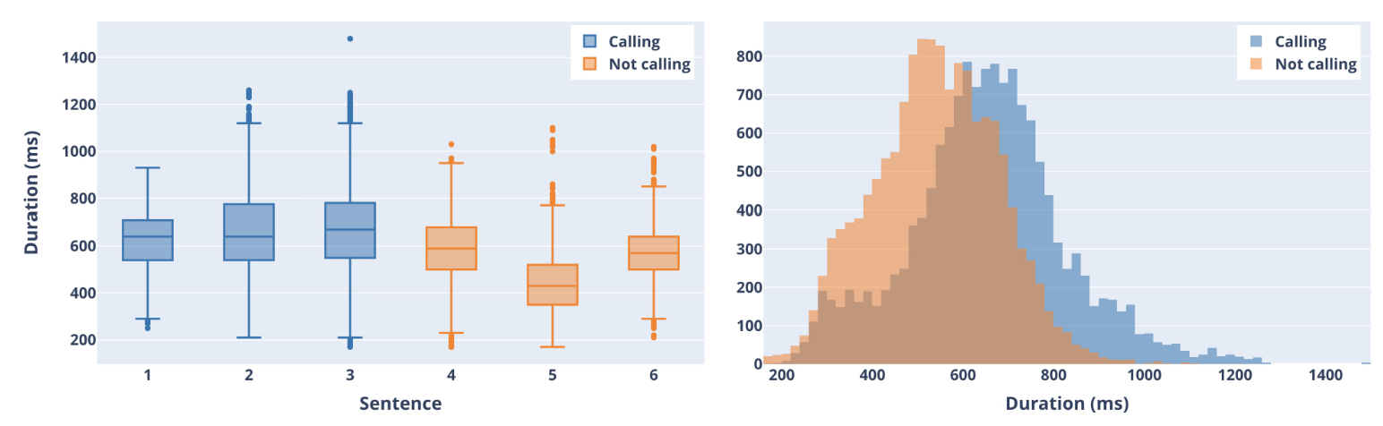
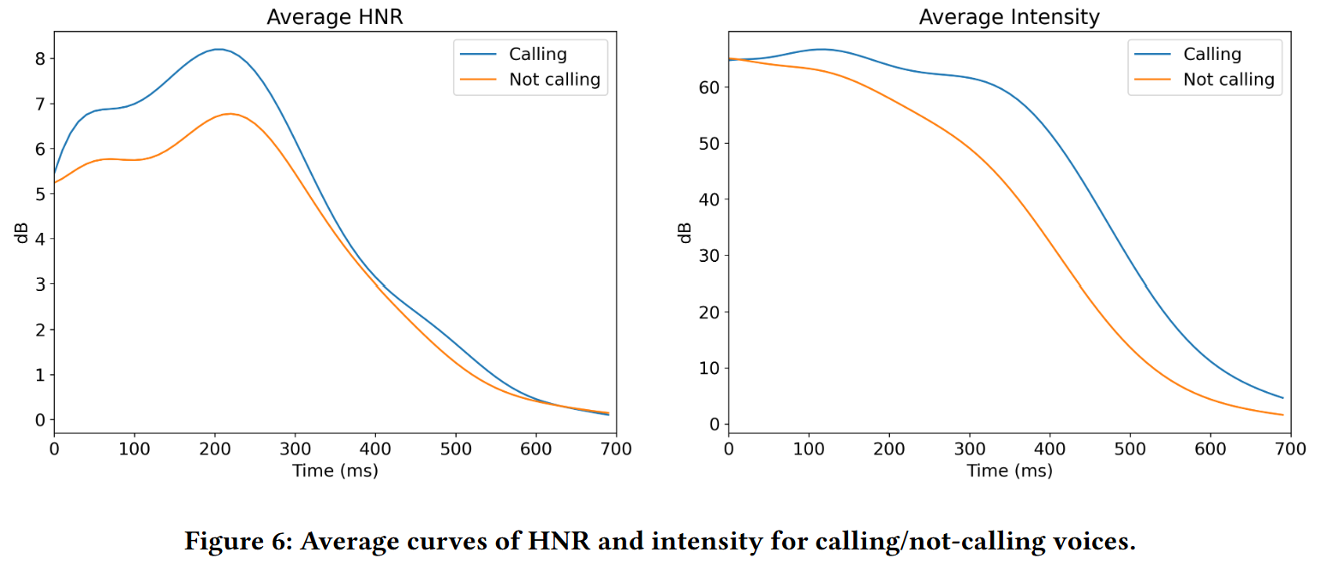
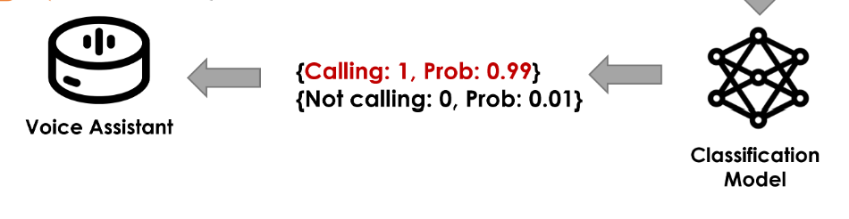
Aware: Intuitive Device Activation Using Prosody for Natural Voice Interactions (CHI 22)
Classifier
Created models to classify calling and non-calling
Tested CNN (.869), SVM (.835), FCNN (.843)
CNN model was lightweight, deployable to Pi
Cross-keyword testing yielded 84.91% accuracy
Prototype
Built Alexa-like device with new recognizer
14 participants hold a natural conversation about the device, both referring to it with both calling and non-calling intentions
.74 score is recognizing non-calling, .52 in recognizing calling due to unseen speaker patterns
Compared to Amazon Echo, with score .56
Users eventually learned correct prosody for new device
Mixed subjective responses on device preference
Discussions on model robustness, prosody variation in general public

Slide 18
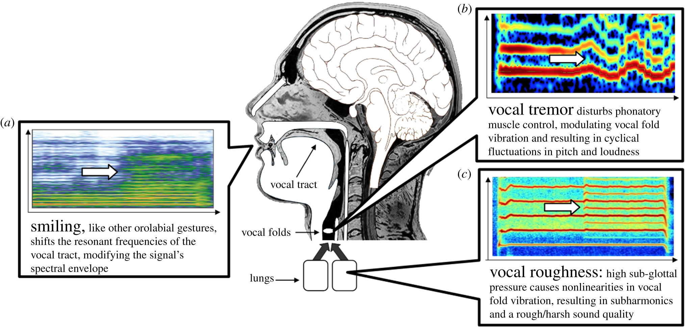
Even violins can cry: specifically vocal emotional behaviours also drive the perception of emotions in non-vocal music (2021)
https://royalsocietypublishing.org/doi/full/10.1098/rstb.2020.0396
Vocal behaviors for conveying emotion still evoke emotional effects in non-vocal sounds
Both vocal (speech) and non-vocal (music) sounds evoke emotion, but previously unknown if through the same mechanism
I.e. general characteristics like pitch, intensity, etc. exist in both speech and noise, so maybe human mechanism to process sound are not in reference to human voice
Experiment
Adjust voice-specific characteristics in sound: smiling (frequency warping), vocal tremor (cyclical pitch shift), and roughness (amplitude modulation and subharmonics)
Applied to both vocal and non-vocal music
60 Participants rated emotional valence and arousal
29 musicians, 31 non-musicians

Slide 19
Even violins can cry: specifically vocal emotional behaviours also drive the perception of emotions in non-vocal music (2021)
Results
Smiling increased valence and arousal
Tremor decreased valence and decreased arousal for speech stimuli (contrary to previous work)
Roughness decreased valence and increased arousal for scream sounds
Similar effects for non-vocal music (violin)
Effects stronger on isolated singing than with musical accompaniment
Musicianship had no effect
Discussion concludes musical emotions stem from acoustic features resembling human voice
Congruency between vocal feature and affected sound increased emotional effect
Suggest singing and non-vocal music can be processed as if they were spoken voice

Slide 20
Voichap: A standalone real-time voice change application on iOS platform (APSIPA 2017)
https://ieeexplore.ieee.org/document/8282129
How can we mimic someone else’s voice?
Accomplished through mobile app
Voice conversion done locally within reasonable time by choosing HSM over deep learning approaches
Requires training on user’s voice and target voice
HSM Approach
Represent speech as sum of harmonic sinusoids with time-varying parameters and noise-like stochastic component
In training phase, a conversion model is generated from source vs. target voice inputs
In conversion phase, voice is converted by modifying voice features
Section 3 explains technical choices to optimize performance
Section 4 explains UI

Slide 21
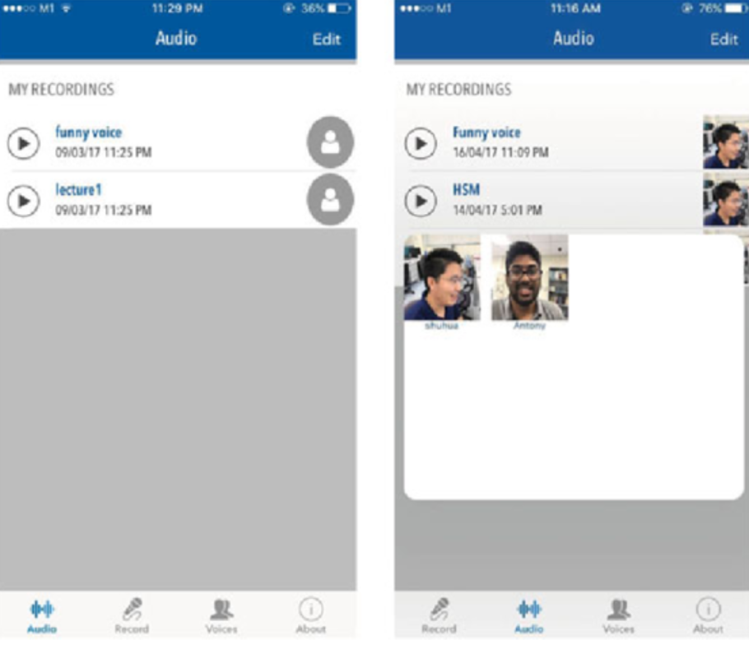
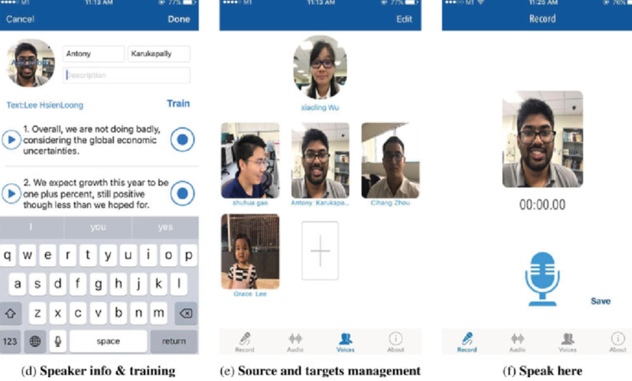
Usage
Can choose and train new target voices
For training, user and target must provide about 20 samples, speaking the same uterrances
Training takes about 40 seconds, after which the conversion model is generated and can be used repeatedly
10-second utterance converts in about 1.5 seconds
Notable Points
Demonstrates adjustment of vocal features in existing speech audio to produce other voices
Adaptable to any new voice
Performs in relative real-time (must speak entire utterance then convert)

Slide 22
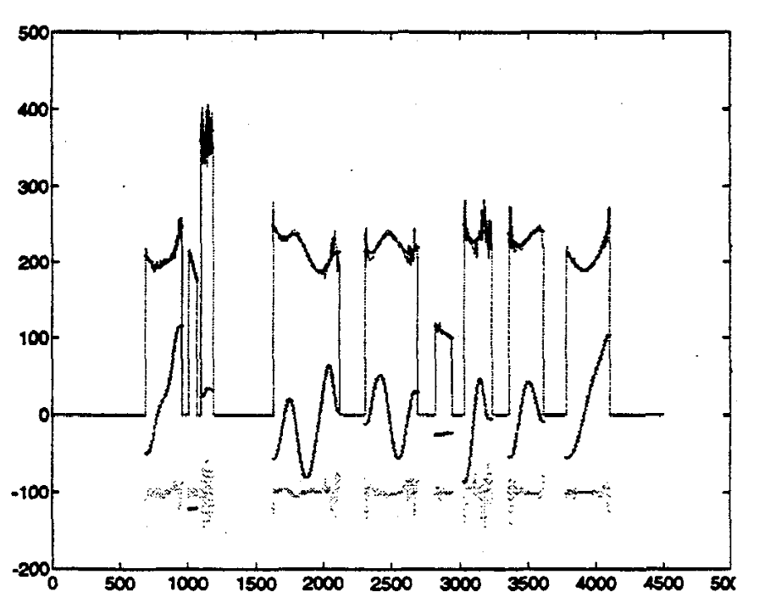
Recognizing Emotion In Speech (ICSLP 1996)
https://ieeexplore.ieee.org/stamp/stamp.jsp?tp=&arnumber=608022
Techniques for classifying emotion in speech
Data collected by actors vocalizing sentences in given emotion
Feature Extraction
Recognition highly dependent on summary features of f0
Simple Feature Set (7) – mean, std, min, max, range, slope, speaking rate
Improved Set (17)
Performed cubic spline smoothing on pitch contour
Rhythm, smoothed signal, derivative, individual voiced parts, individual slopes
Tested classification by MLB, KR, and KNN
KNN performed best
Proposed majority voting algorithm to classify
Notable Points
Most significant features from Simple Set were max, min, and mean
Most significant features from Improved Set were max, min of pitch and mean positive derivative of vocalizations where pitch increased

Slide 23
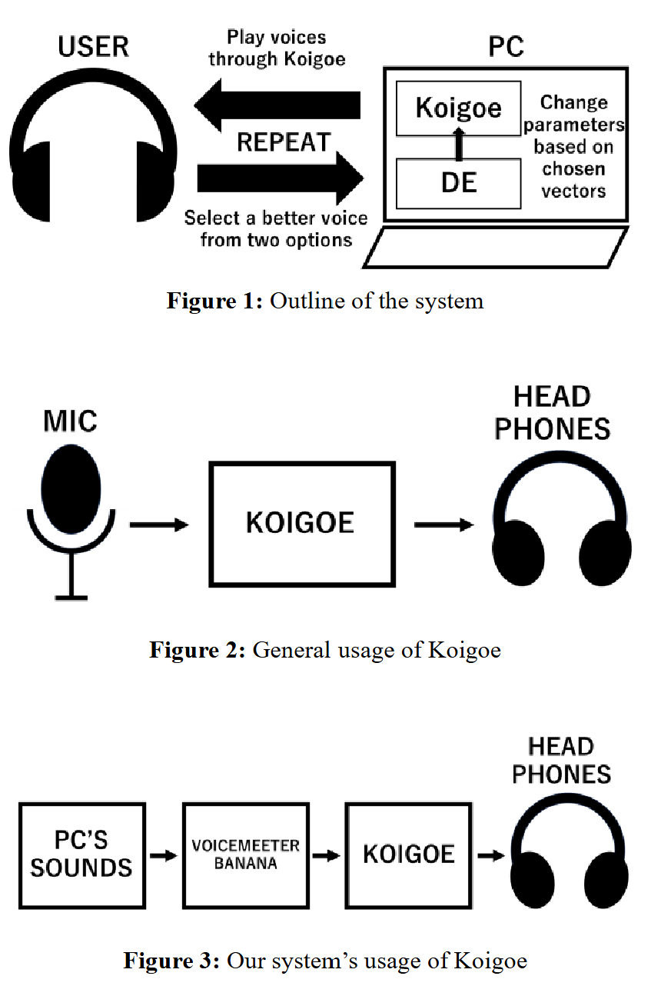
Making English Voices Similar To User’s Voices Using Voice Changer and Interactive Differential Evolution (ISASE 2024)
https://www.jstage.jst.go.jp/article/isase/ISASE2024/0/ISASE2024_1_10/_pdf/-char/ja
Can English voices be adjusted to a user’s preference?
Uses Koigoe to transform audio
Parameters
Pitch
Formant
Gender
C0 – C10: Equalizers, represent decibels of each pitch
System
Use Paired Comparison-based IDE, heuristic optimization, mutation and crossover of parameters
10 evolutions through experiment
Users listen to 2 voices and choose the one most similar to the voice in their mind
Authors claim using real-time audio, but also generated sentences through ChatGPT
No significant change in parameters, but significant change in user evaluation of voices
Notable Points
Confusing paper, lacks a lot of details

Slide 24
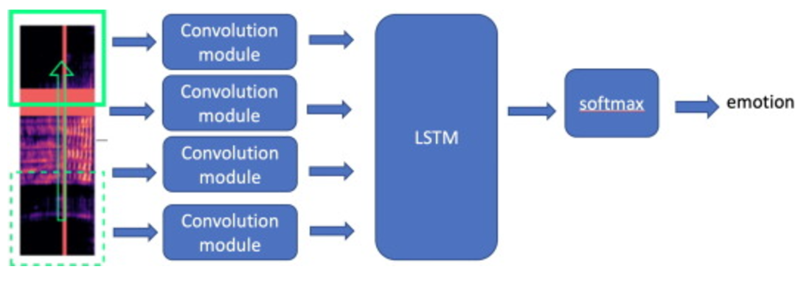
An ongoing review of speech emotion recognition (2023)
https://www.sciencedirect.com/science/article/pii/S0925231223000103
Classical and recent approaches to speech emotion recognition (SER)
Compilation of popular audio-visual-emotional databases, spanning various languages and emotions
Machine Learning Approaches
SVM is most popular, as well as GMM, MLP, BN, LR, kNN, etc.
Common features are pitch, formants, intensity, mel frequency cepstral coefficients (MFCC), etc.
Common techniques are smoothing, normalization, feature extraction, dimensionality reduction
Real-time and multimodal approaches currently being explored
Deep learning approaches include CNNs, LSTM, RNNs, etc.
Common data formats are raw audio, pitch contours, mel spectrograms, etc.

Slide 25
Convert and Speak: Zero-shot Accent Conversion with minimum Supervision (MM 2024)
https://openreview.net/pdf?id=ay1Tv3PcNw
Modulate speech to a target accent
Challenge is low data resources, since both pronunciation and prosody must be converted
Proposed solution is two-stage process, where decoupling the above reduces data complexity
Convert – Only convert semantic tokens, less data necessary now
Speak – Synthesize speech in by model of target accent domain conditioned on semantic tokens, now has access to all speaking data in target accent
Experimented with converting Indian-English to American-English, promising results
Can produce comparable utterance in target accent with only 15 minutes of weakly parallel data, not constrained by speaker
Further exploration with various accents reveals potential for adaptable framework
Notable Points
Demo samples available online
Unclear if this is real-time

Slide 26
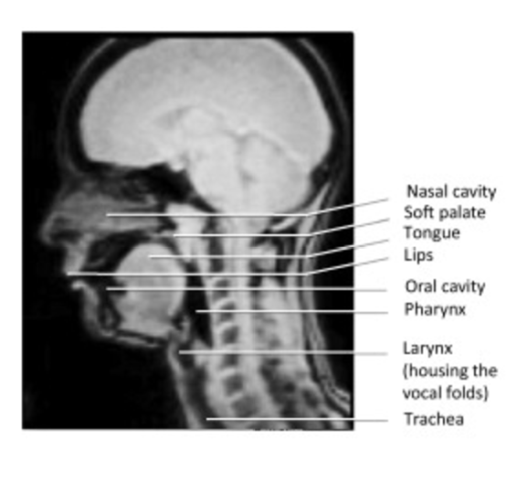
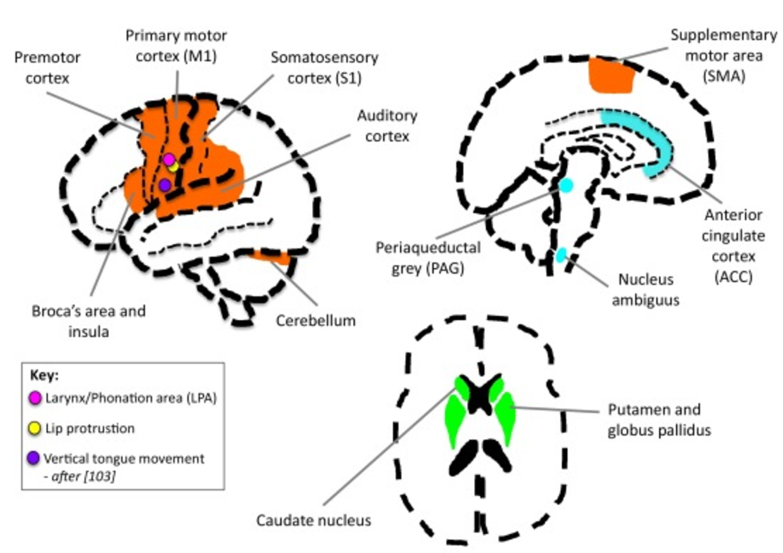
Voice Modulation: A Window into the Origins of Human Vocal Control? (2016)
https://www.cell.com/trends/cognitive-sciences/fulltext/S1364-6613(16)00020-6
Humans modulate formants and nonverbal uterances, how did this arise?
Source-Filter Theory for Speech Production
Voice signals produced by larynx and filtered by vocal tract
Air expelled from lungs and forced through closed glottis, causing oscillations of larynx vocal folds – this produces f0
Sound waves travel through pharynx and supralaryngeal vocal tract (oral and nasal cavities)
Tract and mouth filters sound and attenuates frequencies, leading to individual voice timbres
F0 lowers with larger, stretched, and/or tenser vocal folds
Vocal Modulation
Listeners can recognize voluntary modulation, but are still susceptible to the associated assumed characteristics of the speaker
Dual-Pathway Model: suggests humans use 2 neural pathways for speech perception – motor-speech system and lexical-conceptual system
Notable Points
Neuroanatomy of vocal control
Outstanding questions to address

Slide 27
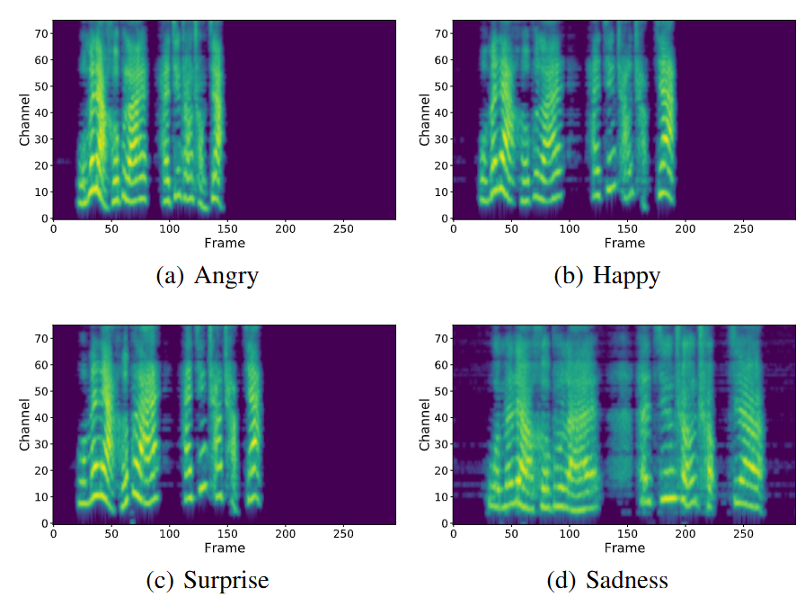
Controllable Multi-Speaker Emotional Speech Synthesis with Emotion Representation of High Generalization Capability (IEEE Affective Computing 2024)
https://ieeexplore.ieee.org/stamp/stamp.jsp?tp=&arnumber=10553521
Techniques to generate speech with configurable content, emotion, and timbre
For TTS
Developed generalization model to represent emotion and timbre independently
Trained on audio databases with multiple speakers from English and Mandarin backgrounds
Complex algorithm and deep learning to train speech representations
Can apply targeted emotion and timbre, separately, onto input speech by referencing previously learned representations
Can adjust emotional intensity
Resulting synthetic speech is impressive but still distinguishable from real speech
Notable Points
High interest in emotional speech, but mostly for TTS
No interface, all user study audios were prepared beforehand

Slide 28
The shallow of your smile: the ethics of expressive vocal deep-fakes
https://royalsocietypublishing.org/doi/10.1098/rstb.2021.0083
Ethical study on Are users open to vocal modulation? What are the ethical/moral implications?
303 online participants (mostly college students)
Asked to read 24 short stories of using an imaginary device that could transform the emotional quality of a voice in real-time
Stories covered use cases of device usage by participant or other, therapeutic transformations vs. user capacity enhancement, operating on positive vs. negative emotions, and transformations affected how others hear the user, how the user hears others, or how the user hears themselves
Participants rated acceptability of each scenario, if lying about the true purpose of the device was acceptable, and their attitudes towards morality (MFQ) and tech / science fiction (SFH)
Notable Points
Population generally accepts voice transformations
Therapeutic context found more acceptable than enhancement
Manipulating perception less acceptable than manipulating production
Covert use of the device is acceptable, unless the user of the device is unaware
Reducing negative emotions tended to be more acceptable than enhancing positive, but both acceptable

Slide 29
Voicecoach: Interactive evidence-based training for voice modulation skills in public speaking (CHI 2020)
https://dl.acm.org/doi/abs/10.1145/3313831.3376726?casa_token=Cino7uAkQfsAAAAA:FoTJKShpnajuzbhPkGVFyr9aH7xsTHJcpQZXj_O1LftvAwikmv4I7pYGkCQ3AAPR5ylPHNFqaWjjDQ
Provides public speaking training tailored to user
Compiled large set of TEDTalks as benchmark
Analyzes user’s speech and provides similar benchmark example for training
Provides additional live visual feedback for training

Slide 30
Action Items

Slide 31
Main Challenges
Training necessary for within-individual modulation
What voice/prosody features to change? What emotions to target?
Are we modulating the speaker’s production? Or listener’s perception?
Real-time modulation poses algorithm challenges
If live modulation, how to decide factors without knowing the entire vocalization?
Background noise (for demos)
Ethical concerns

Slide 32
Possible Names
AutoTone
ToneTune
InTone

Slide 33
Background Summary
Speech synthesis is already exhaustive (ChatGPT)
Current focus on models and accuracy
Real-time is iffy
Lack of environment awareness, no direct connection to intended effect
Intended effect must be predetermined
Applications are scattered and shallow
TTS and interactive voice agent is plentiful
Less active modulation on user

Slide 34
Proposal

Slide 35
Story | Structure | Variables | Implementation | Action Items
Feasibility and Acceptability of Voice Modulator in Real-World Social Settings
Research Questions
Can a voice modulating device be naturally integrated with everyday interactions?
Will it technically perform in real-time w/o disrupting natural conversation?
Will people accept a voice modulation device? Under what circumstances?
Contributions
Focus on application and effects of voice modulation through novel, multipurpose interface
real-time on natural speech (applying existing models)
Taxonomy – Use Case vs. Modulation Characteristics
Expanding voice modulation beyond current niche usage

Slide 36
Story | Structure | Variables | Implementation | Action Items
Study 1 - Device Exploration: what physical characteristics make the best modulator?
Hypothesis - Low profile, real-time, produces comparable voice, etc.
Study 2 – Taxonomy & Categorization: for each use case, what configuration is best? (vocal parameters)
Can users find a target voice? What is target voice for each use case?
Ex. In public speaking, prioritize high energy and clarity of speech
Study 3 – Acceptability: For which use cases will people actually use this interface? (social parameters)
Hypothesis – When need for intimacy or genuineness is low
Ex. Public speaking (TED talk), therapy (patient), business meetings
Counter ex. Public speaking (Politician), therapy (therapist), 1-1 talks

Slide 37
Story | Structure | Variables | Implementation | Action Items
Independent
Perspective – speaker vs. listener, production vs. recognition
Modality – In-person vs. video call vs. voice call, audio + visual
Environment – Targeted audience, audience size, social expectations background noise
Vocal – Emotion, tone, accent, etc.
Purpose – Content of speech, intended effect
Device Characteristics – form, visibility, temporal lag, etc.
Dependent
Speech comprehension, speaker evaluation, listener engagement, device acceptability

Slide 38
Story | Structure | Variables | Implementation | Action Items
Use Cases
Public speaking – business, education, politics, practice
Personal Conversation – professional, friendly, intimate
Therapy – emotion expression, emotion regulation, trauma processing
Online – meetings, voice calls
Parasocial – radio, streamers
Voice Acting
Etc.

Slide 39
Story | Structure | Variables | Implementation | Action Items
Voice Modulating Device
User has target voice in mind (based on social setting)
User finds target voice by applying intended effects on their voice (ex. More positive)
We provide interface and framework for modulating effects
UI, compilation of effect models, environment consideration
User adjusts effects to find target voice (ex. Emotion slider)
Models are plug-&-play, expandable
Audio provided to device, whether by speaking or listening, is modulated according to user’s choice

Slide 40
Story | Structure | Variables | Implementation | Action Items
Equipment
Minimal hardware needed
Use preexisting models, focused on interface and context over algorithm
Major Challenges
Detecting use case – manual vs. audio recognition vs. multimodal recognition (ex. + visual)
Lots of options - Deciding which use cases are significant and generalizable
Simulating each use case for studies (ex. maybe VR for public speaking)
Quantitative results

Slide 41
Story | Structure | Variables | Implementation | Action Items
Test prototype
Simple, single-purpose voice modulator through phone and earbuds
Will it be too disruptive to hold conversation?
Shrink scope on use cases and variables
Determine targeted use cases -> intended effect -> voice characteristics to modulate
Determine if models for above exist, and which to use
Explore device design and hardware, expecting forms similar to existing devices
Mic pack for speaker, software on earbuds for listener

Slide 42
Samples

Slide 43
Samples
Twas brillig, and the slythy toves did gire and gimble in the wabe. All mimsy were the borogoves, and the momewraths outgrabe.

Slide 44
Prototyping

Slide 45

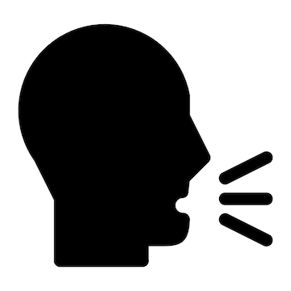

Goal
An adaptive voice modulator that detects the context of a conversation over time and modulates the user’s voice with the appropriate emotion and tone
Understand the context
Choose a voice
Modulate user’s speech

Slide 46
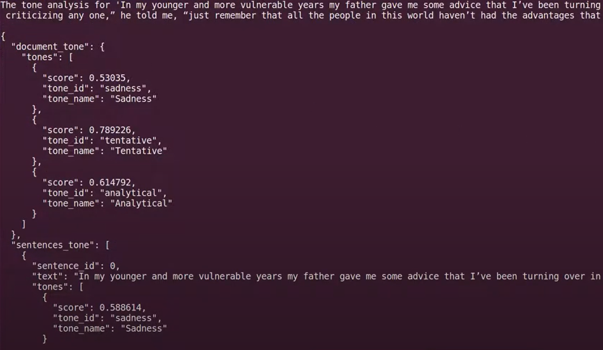
Context Detection
Audio-to-Text Transcription
Record conversation as text in real-time
Consider multiple speakers
Determine Conversational Context
IBM Watson NLU and Tone Analyzer
Extracts meaning and tone from text - sentiment/emotion, relevant concepts, delivery, etc.

Slide 47
Voice Selection
Predetermined Voice Profiles
Connect given tone to desirable voice features
Six Basic Emotions
Happiness, Sadness, Anger, Fear, Surprise, Disgust
Typically recognized universally across cultures
Considered instinctual and quickly/unconsciously expressed
 | Happiness | Sadness | Anger | Fear | Surpise | Disgust
Pitch | High | Low | Often high, low for emphasis | High | Very high | Low, fluctuates
Intensity | High | Low | High | Either | High | Medium – High
Rate | Fast | Slow | Fast, clipped | Fast, erratic | Fast | Slow
Tone | Bright, melodic | Dull, flat | Tense, sharp | Shaky | Abrupt | Nasal

Slide 48
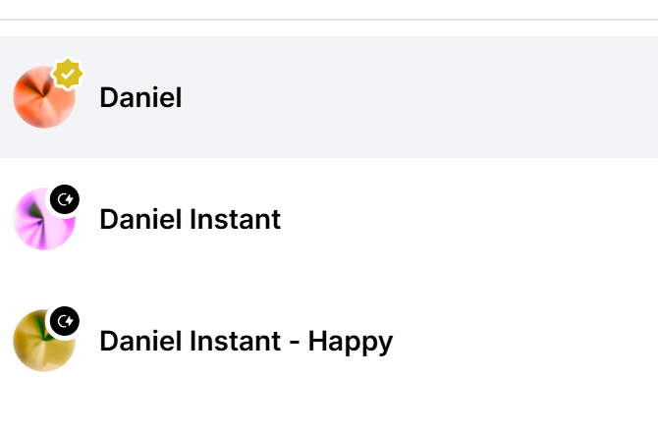
User Modulation
Real-time Voice Modulation
Once context is determined, apply appropriate voice
Need to pretrain on user’s voice
Train each voice profile separately?
Voice Cloning - ElevenLabs
Instant Cloning in 30s - passable quality
Professional Cloning in 30min – high quality but limited usage
Usage rate
Need to train each voice profile
Not real-time

Slide 49
Conversational Contexts
Conversational Context
Emotion – Neutral vs positive vs negative
Social Function – formal vs casual vs intimate vs persuasive
Medium – In-person vs digital vs broadcast
Intent – informative vs entertaining vs supportive vs conflict
Audience – Individual vs small group vs mass

Slide 50


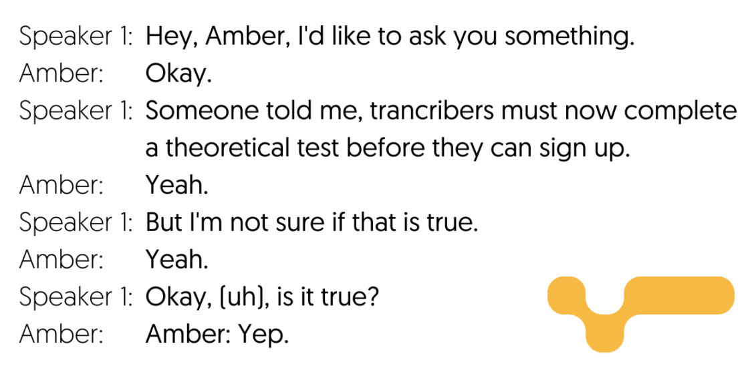

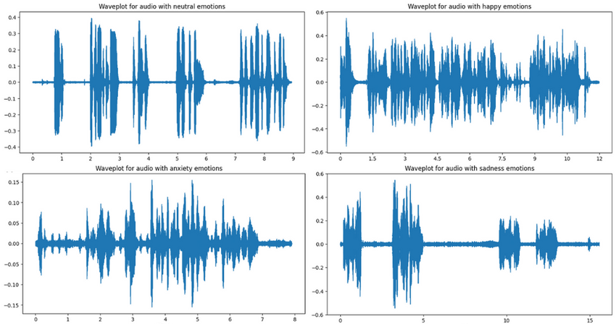
User has conversation
Audio transcribed to text
Context extracted from text
Modulate user’s voice
Appropriate voice selected
User pretrains voice profiles

Slide 51
Tech Options
Audio-to-Text Transcription & Context Extraction
Rev AI
OpenAI (Whisper & API)
IBM Watson NLU and Tone Analyzer
Affectiva
NVIDIA Jarvis
Voice Training and Modulation
ElevenLabs
Descript
VoiceMod
OpenAI in the future

Slide 52
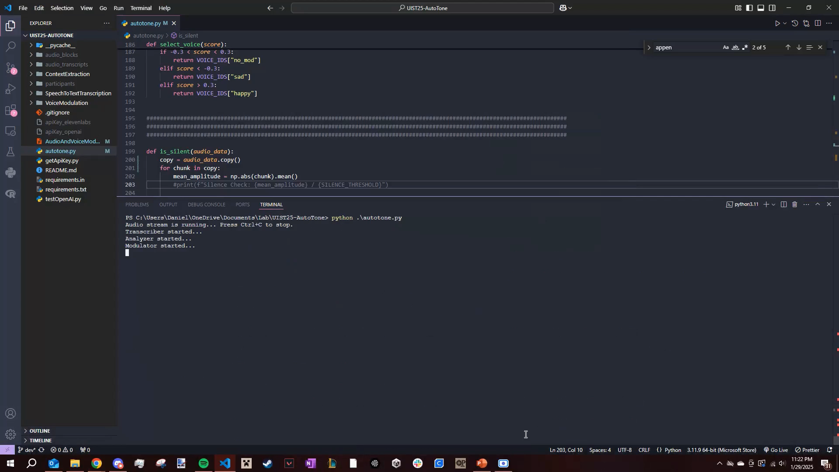
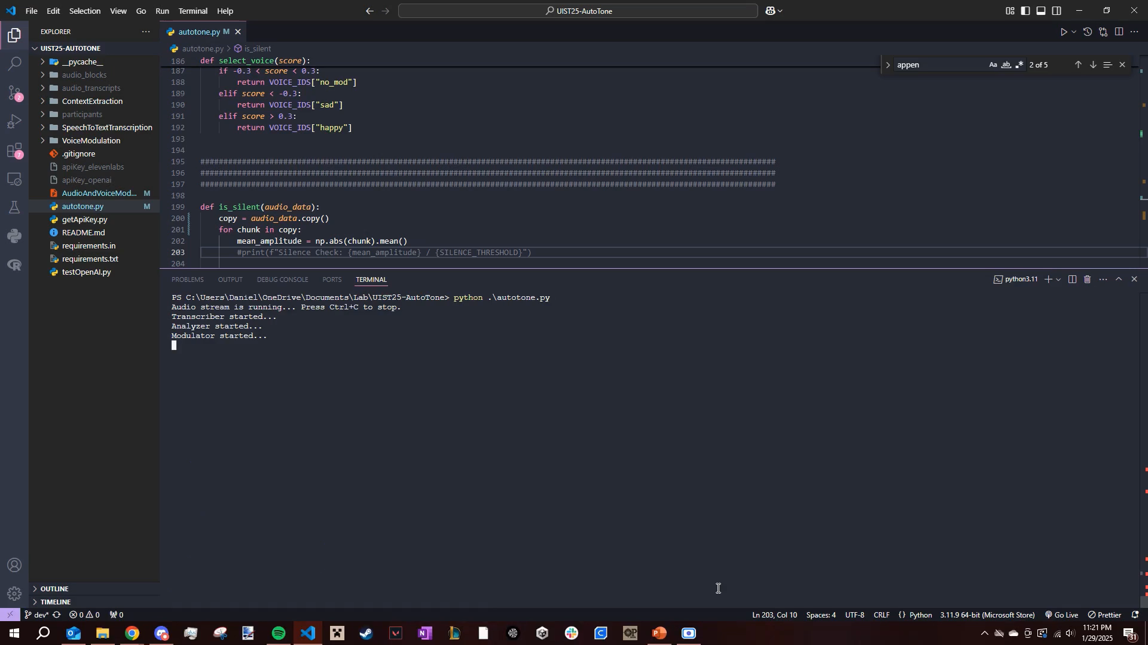
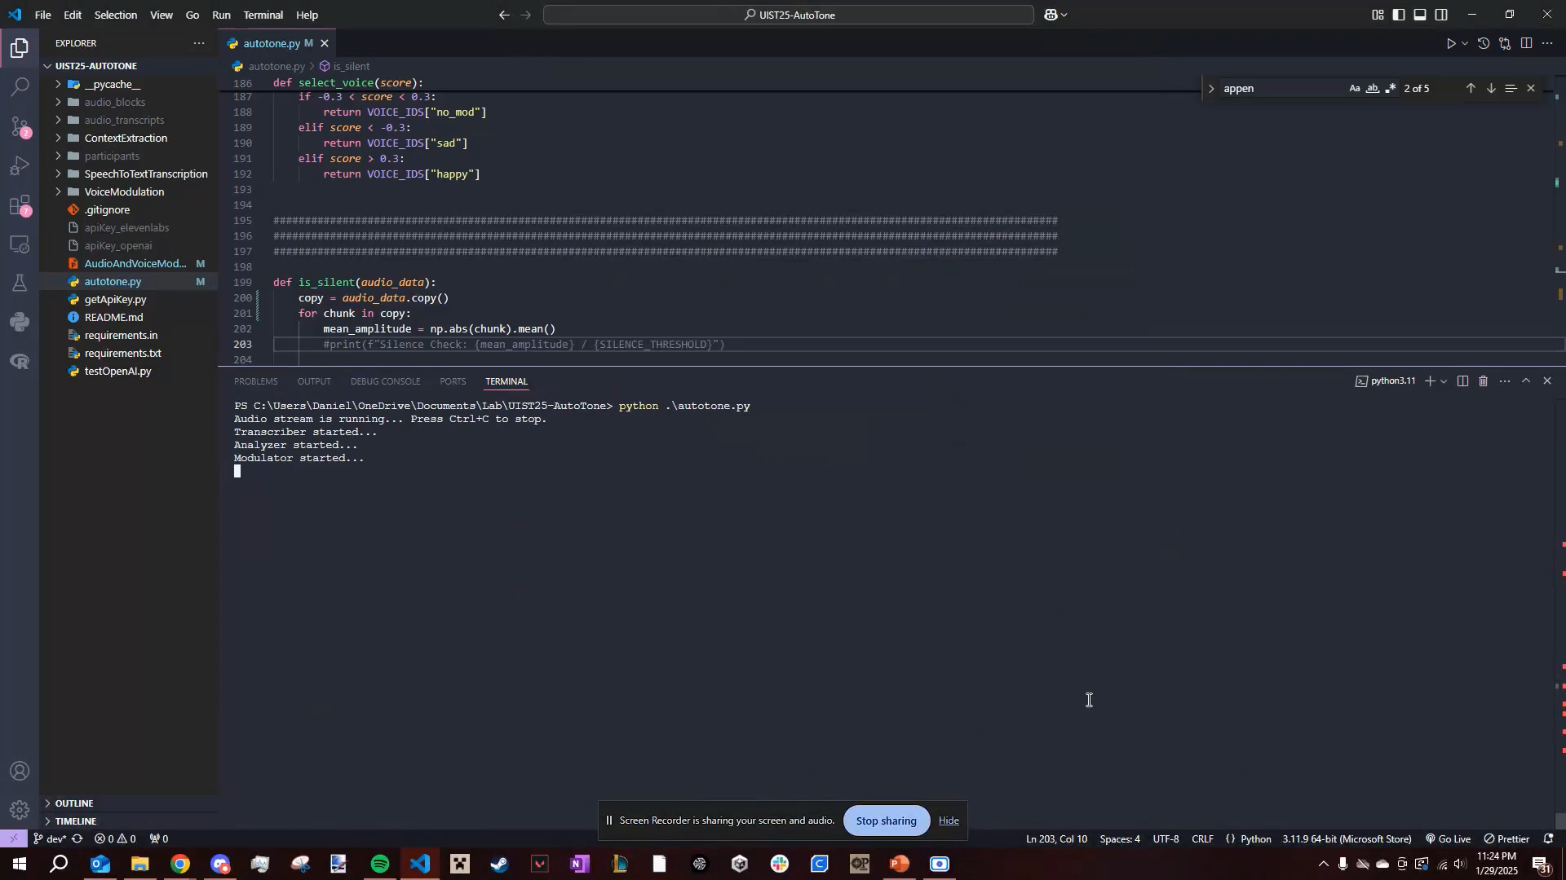
Prototype
Happy
Sad
Switch

Slide 53
Next Directions
Multimodal Awareness
Face analysis
Visual processing of environment
Body language
Diction Modulation
Changing the actual words and text being spoken
ex. User was too informal, modulator rewords with professional speech

